Slide 1

1. Getting started with django (Creating the project and running the server)
Md. Nahiyan Uddin
Lecturer
Department of CSE
University of Asia Pacific

Slide 2
Objectives
Install an IDE, create a project directory and setup the virtual environment
Install Django
Start the project
Create apps
Run the server

Slide 3
Install an IDE
We can use
pycharm or
Visual Studio Code

Slide 4
Working with Pycharm
Download and the pycharm ide in your computer from the below link –
https://www.jetbrains.com/pycharm/download/

Slide 5
Pycharm Additions
There are three additions in pycharm –
Community edition
Professional edition
Education Edition

Slide 6
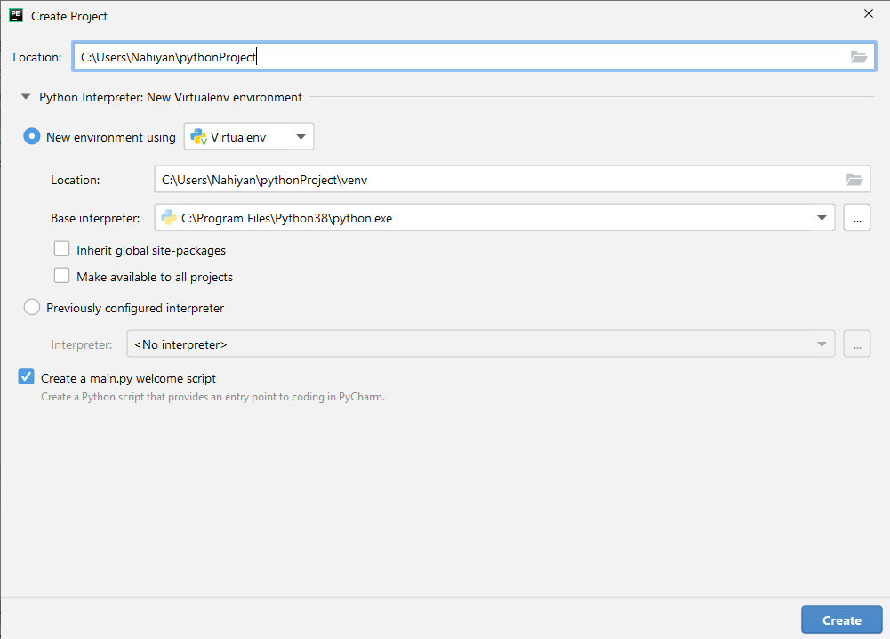
Creating a project

Slide 7
Working with VSCODE
Steps:
Install python extension
Create project folder in file system and open the folder in VSCode
Open a new terminal in vs code and create a virtual environment by running the following command-
python -m pip install --upgrade pip
pip install virtualenv
python –m venv venv

Slide 8
Activating the virtual environment
After opening the project, the virtual environment should be automatically activated and it would look like similar to this –
If not, it will look like this-
Then we do run the following command in the terminal. It will run a script to activate the virtual environment-
$ .\venv\Scripts\activate

Slide 9
Script Error
Sometimes our systems are disabled to run any scripts. So, the following error will occur-
Fix:
we need to run the following command in the terminal first-
$ Set-ExecutionPolicy -Scope CurrentUser -ExecutionPolicy Unrestricted
Then run the script to activate the virtual environment-
$ .\venv\Scripts\activate

Slide 10
Objectives
Install an IDE, create a project directory and setup the virtual environment
Install Django
Start the project
Create apps
Run the server

Slide 11
Installing django
Open the terminal and run the following commands
$ pip install django
$ django-admin startproject pythonProject .
$ django-admin startapp demo
To run the server-
$ python manage.py runserver

Slide 12
Objectives
Install an IDE, create a project directory and setup the virtual environment
Install Django
Start the project
Create apps
Run the server

Slide 13
Start a project
Open the terminal and run the following commands
$ django-admin startproject pythonProject . (Do not forget the dot)

Slide 14
Objectives
Install an IDE, create a project directory and setup the virtual environment
Install Django
Start the project
Create apps
Run the server

Slide 15
Create the apps
Open the terminal and run the following commands
$ django-admin startapp <app_name>
or
$ python manage.py startapp <app_name>

Slide 16
Objectives
Install an IDE, create a project directory and setup the virtual environment
Install Django
Start the project
Create apps
Run the server

Slide 17
Run the server
To run the server-
$ python manage.py runserver

Slide 18
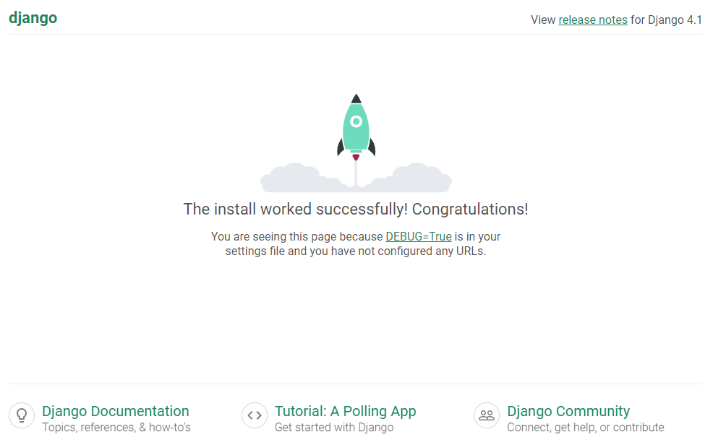

Slide 19
Objectives
Install an IDE, create a project directory and setup the virtual environment
Install Django
Start the project
Create apps
Run the server

Slide 20


Slide 21
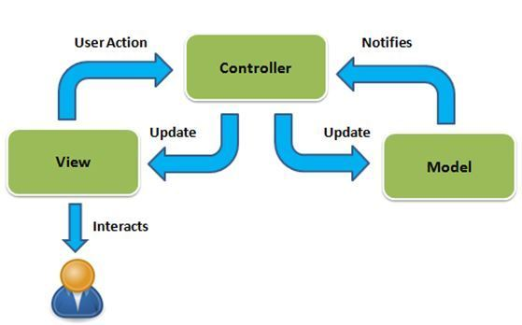
MVC Pattern

Slide 22
django mvc
urls.py
models.py
views.py

Slide 23
Create Sub-systems (apps)
django-admin startapp demo
python manage.py startapp demo2

Slide 24
Front-End (client) – Back-End (server)
Frond-End
Back-End
Full-Stack
Front-End -> Request -> Back-End
Back-End -> Response -> Front-End

Slide 25
Next Topic: Templates
Httprespond()
render()

